Slide 1
CHAPTER 9
Estimation from Sample Data
to accompany
Introduction to Business Statistics
seventh edition, by Ronald M. Weiers
Presentation by Priscilla Chaffe-Stengel
Donald N. Stengel
© 2011 Cengage Learning.
All Rights Reserved. May not be scanned, copied, or duplicated, or posted to a publicly accessible website, in whole or in part.

Slide 2
Chapter 9 - Learning Objectives
Explain the difference between a point and an interval estimate.
Construct and interpret confidence intervals:
  with a z for the population mean or proportion.
  with a t for the population mean.
Determine appropriate sample size to achieve specified levels of accuracy and confidence.
© 2011 Cengage Learning.
All Rights Reserved. May not be scanned, copied, or duplicated, or posted to a publicly accessible website, in whole or in part.

Slide 3
Chapter 9 - Key Terms
Unbiased estimator
Point estimates
Interval estimates
Interval limits
Confidence coefficient
Confidence level
Accuracy
Degrees of freedom (df)
Maximum likely sampling error
© 2011 Cengage Learning.
All Rights Reserved. May not be scanned, copied, or duplicated, or posted to a publicly accessible website, in whole or in part.

Slide 4
Unbiased Point Estimates
Population Sample
Parameter Statistic Formula
Mean, µ
Variance, σ²
Proportion, π
∑
x
x
x
=
i
n
∑
(
x
–
x
)
2
s
2
s
2
=
i
n
–
1
p
p
=
x
successes
n
trials
© 2011 Cengage Learning.
All Rights Reserved. May not be scanned, copied, or duplicated, or posted to a publicly accessible website, in whole or in part.

Slide 5
Central Concepts Applied
Example, Problem 9.11: In surveying a simple random sample of 1000 employed adults, we found that 450 individuals felt they were underpaid by at least $3000. Based on these results, we have 95% confidence that the proportion of employed adults who share this sentiment is between 0.419 and 0.481.
Point estimate: 450/1000 = 0.45
Confidence interval estimate: [0.419, 0.481]
Confidence coefficient and confidence level:
95% and 0.95
Accuracy: (0.45 – 0.419) = (0.481 – 0.45) = 0.031
© 2011 Cengage Learning.
All Rights Reserved. May not be scanned, copied, or duplicated, or posted to a publicly accessible website, in whole or in part.

Slide 6

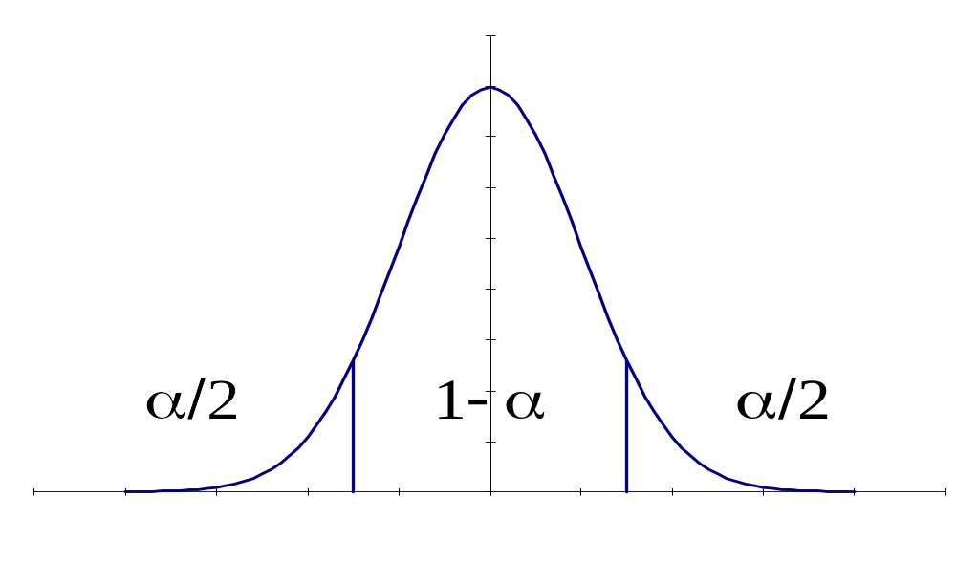
Confidence Interval: µ, σ Known
where = sample mean ASSUMPTION:
σ = population standard infinite population
deviation
n = sample size
z = standard normal score
for area in tail = α/2
z
:
–
z
0
+
z
σ
σ
x
:
x
–
z
⋅
x
x
+
z
⋅
n
n
© 2011 Cengage Learning.
All Rights Reserved. May not be scanned, copied, or duplicated, or posted to a publicly accessible website, in whole or in part.

Slide 7
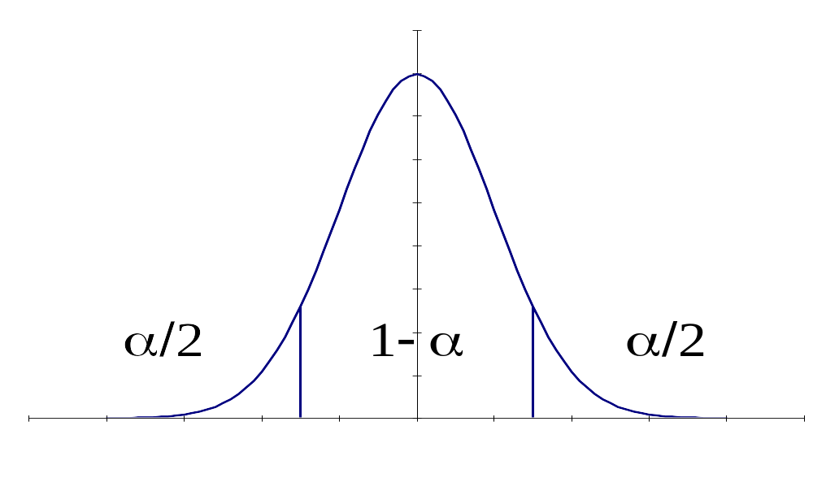
Confidence Interval: µ, σ Unknown
where = sample mean ASSUMPTION:
s = sample standard Population
deviation approximately
n = sample size normal and
t = t-score for area infinite
in tail = α/2
df = n – 1
t
:
–
t
0
+
t
⋅
s
+
⋅
s
x
:
x
–
t
x
x
t
n
n
© 2011 Cengage Learning.
All Rights Reserved. May not be scanned, copied, or duplicated, or posted to a publicly accessible website, in whole or in part.

Slide 8
Confidence Interval on π
where p = sample proportion ASSUMPTION:
n = sample size n•p ≥ 5,
z = standard normal score n•(1–p) ≥ 5,
for area in tail = α/2 and population
infinite
z
:
–
z
0
+
z
⋅
p
(
1
–
p
)
+
⋅
p
(
1
–
p
)
p
:
p
–
z
p
p
z
n
n
© 2011 Cengage Learning.
All Rights Reserved. May not be scanned, copied, or duplicated, or posted to a publicly accessible website, in whole or in part.

Slide 9
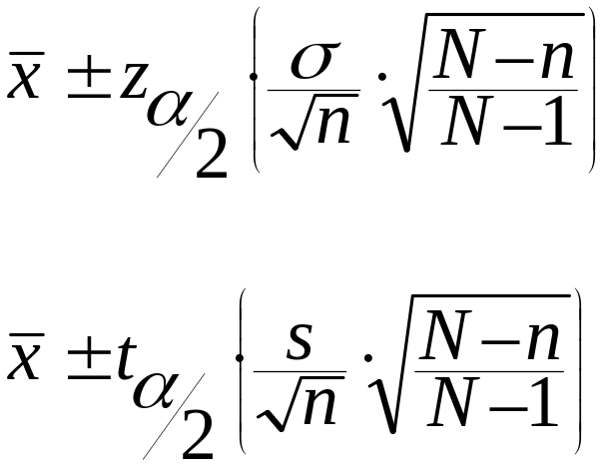
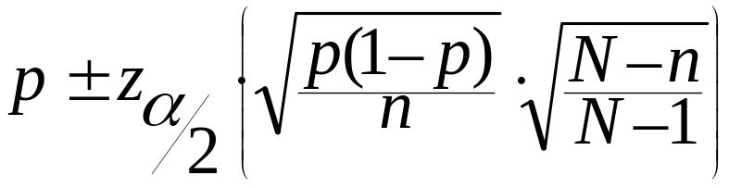
Converting Confidence Intervals to Accommodate a Finite Population
Mean:
or
Proportion:
© 2011 Cengage Learning.
All Rights Reserved. May not be scanned, copied, or duplicated, or posted to a publicly accessible website, in whole or in part.

Slide 10
Interpretation of
Confidence Intervals
Repeated samples of size n taken from the same population will generate (1–α)% of the time a sample statistic that falls within the stated confidence interval.
© 2011 Cengage Learning.
All Rights Reserved. May not be scanned, copied, or duplicated, or posted to a publicly accessible website, in whole or in part.

Slide 11
Sample Size Determination for µ from an Infinite Population
Mean: Note σ is known and e, the bound within which you want to estimate µ, is given.
  The interval half-width is e, also called the maximum likely error:
  Solving for n, we find:
e
=
z
⋅
σ
n
2
⋅
σ
2
=
z
n
2
e
© 2011 Cengage Learning.
All Rights Reserved. May not be scanned, copied, or duplicated, or posted to a publicly accessible website, in whole or in part.

Slide 12
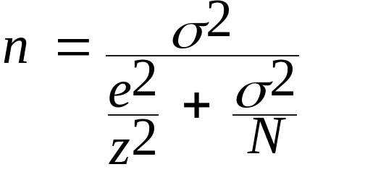
Sample Size Determination for µ from a Finite Population
Mean: Note σ is known and e, the bound within which you want to estimate µ, is given.
where n = required sample size
N = population size
z = z-score for (1–α)% confidence
© 2011 Cengage Learning.
All Rights Reserved. May not be scanned, copied, or duplicated, or posted to a publicly accessible website, in whole or in part.

Slide 13
Sample Size Determination for π from an Infinite Population
Proportion: Note e, the bound within which you want to estimate π, is given.
  The interval half-width is e, also called the maximum likely error:
  Solving for n, we find:
e
=
z
⋅
p
(
1
–
p
)
n
z
2
p
(
1
–
p
)
n
=
e
2
© 2011 Cengage Learning.
All Rights Reserved. May not be scanned, copied, or duplicated, or posted to a publicly accessible website, in whole or in part.

Slide 14
Sample Size Determination for π from a Finite Population
Mean: Note e, the bound within which you want to estimate µ, is given.
where n = required sample size
N = population size
z = z-score for (1–α)% confidence
p = sample estimator of π
p
(
1
–
p
)
n
=
2
p
(
1
–
p
e
+
)
2
N
z
© 2011 Cengage Learning.
All Rights Reserved. May not be scanned, copied, or duplicated, or posted to a publicly accessible website, in whole or in part.

Slide 15
An Example: Confidence Intervals
Example, Problem 9.34: An automobile rental agency has the following mileages for a simple random sample of 20 cars that were rented last year. Given this information, and assuming the data are from a population that is approximately normally distributed, construct and interpret the 90% confidence interval for the population mean.
55 35 65 64 69 37 88
80 39 61 54 50 74 92
59 50 38 59 29 60
© 2011 Cengage Learning.
All Rights Reserved. May not be scanned, copied, or duplicated, or posted to a publicly accessible website, in whole or in part.

Slide 16
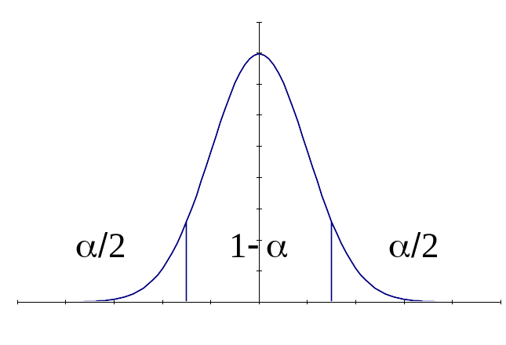
A Confidence Interval Example, cont.
Since σ is not known but the population is approximately normally distributed, we will use the t-distribution to construct the 90% confidence interval on the mean.
x
=
57
.
9
,
s
=
17
.
384
df
=
20
–
1
=
19
,
α
/
2
=
0
.
05
So,
t
=
1
.
729
s
17
.
384
t
:
–
t
0
+
t
x
±
t
⋅
⇒
57
.
9
±
1
.
729
⋅
x
:
x
–
⋅
s
+
⋅
s
t
x
x
t
n
20
n
n
57
.
9
±
6
.
721
⇒
(
51
.
179
,
64
.
621
)
© 2011 Cengage Learning.
All Rights Reserved. May not be scanned, copied, or duplicated, or posted to a publicly accessible website, in whole or in part.

Slide 17
A Confidence Interval Example, cont.
Interpretation:
  90% of the time that samples of 20 cars are randomly selected from this agency’s rental cars, the average mileage will fall between 51.179 miles and 64.621 miles.
© 2011 Cengage Learning.
All Rights Reserved. May not be scanned, copied, or duplicated, or posted to a publicly accessible website, in whole or in part.

Slide 18
An Example: Sample Size
Example, Problem 9.63: A national political candidate has commissioned a study to determine the percentage of registered voters who intend to vote for him in the upcoming election. In order to have 95% confidence that the sample percentage will be within 3 percentage points of the actual population percentage, how large a simple random sample is required?
© 2011 Cengage Learning.
All Rights Reserved. May not be scanned, copied, or duplicated, or posted to a publicly accessible website, in whole or in part.

Slide 19
A Sample Size Example, cont.
From the problem we learn:
  (1 – α) = 0.95, so α = 0.05 and α /2 = 0.025
  e = 0.03
Since no estimate for π is given, we will use 0.5 because that creates the largest standard error.
To preserve the minimum confidence, the candidate should sample n = 1,068 voters.
2
1
.
96
2
(
0
.
5
)(
0
.
5
)
n
=
z
(
p
)(
1
–
p
)
=
=
1
,
067
.
1
e
2
2
(
0
.
03
)
© 2011 Cengage Learning.
All Rights Reserved. May not be scanned, copied, or duplicated, or posted to a publicly accessible website, in whole or in part.

